Slide 1

Vel Tech Rangarajan Dr. Sagunthala R&D Institute of Science and Technology
School of Computing
Department of Computer Science and Engineering
10211CS224 / FULL STACK APPLICATION DEVELOPMENT (JAVA)
END SEMESTER PROJECT REVIEW
Date: 06-05-2026
React JS Based Web Application for Ticket Booking of an Internal Departement Event
SDG: SDG No – SDG 9: Industry, Innovation, and Infrastructure
Presented By:
Mullangi Nagasiri – VTU26656 – 23UECS0293.
Courses Handling Faculty:
Dr. S . HEMAMALINI – M.E., Ph.D.,
Assistant Professor(Senior Grade)

Slide 2
INTRODUCTION
Ticket Booking System is a web-based application developed using React that allows users to view event details and book tickets online.
It simplifies the process of event registration by providing:
Real-time ticket availability
Easy booking interface
Instant confirmation
This system is designed for internal department events such as:
Technical fests
Seminars
Workshops
1
2
3
4
5
6
7
8
9

Slide 3
PROBLEM STATEMENT
1
Traditional ticket booking methods face several issues:
Manual registration is time-consuming
No real-time tracking of ticket availability
Chances of overbooking
Lack of proper validation
Poor user experience
There is a need for a digital, efficient, and user-friendly system to handle event ticket booking.
2
3
4
5
6
7
8
9

Slide 4
OBJECTIVES
1
To develop a user-friendly ticket booking interface
To display event details clearly
To implement real-time ticket availability
To ensure proper input validation
To prevent booking errors
To provide instant booking confirmation email
2
3
4
5
6
7
8
9

Slide 5
PROPOSED SYSTEM
1
The proposed system is a React-based web application
Displays complete event details
Allows users to book tickets online
Validates user input
Prevents overbooking
Updates ticket count dynamically
It ensures a smooth and error-free booking experience
2
3
4
5
6
7
8
9

Slide 6
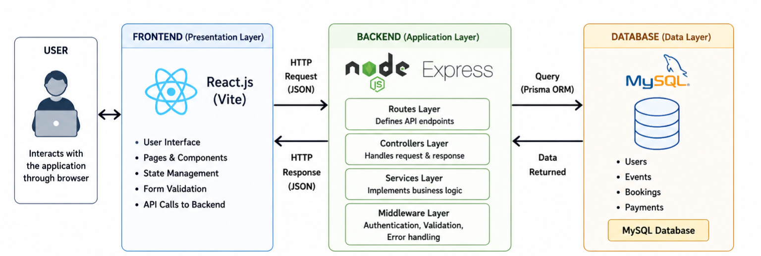
PROPOSED SYSTEM ARCHITECTURE
1
2
3
4
5
6
7
8
9

Slide 7
WORKFLOW
start
1
User Registers / Logs In
2
3
View Events List
4
Select Event
5
Enter Booking Details
6
Confirm Booking
7
Store in Database(MySQL)
8
Show Confirmation
9
End
Notes:
Start

Slide 8
TECHNOLOGIES USED
1
React – Frontend framework
Node.js and Express.js - Backend
JavaScript (ES6) – Logic handling
HTML5 – Structure
CSS3 – Styling and UI design
Vite – Fast development environment
MySQL - Database
2
3
4
5
6
7
8
9

Slide 9
MODULE DESCRIPTION
Module 1: User Authentication Module
The User Authentication Module is responsible for managing user access to the system and ensuring secure authentication.
Module 2: Dashboard and Event Display Module
The Dashboard and Event Display Module acts as the central interface of the application where users can view all available technical events. It displays important information such as event name, available seats, venue, and registration fee.
Module 3: Booking Module
The Booking modeule Accepts essential details such as name, email, department, and number of tickets.
Ensures all fields are properly filled and validates input formats before submission. Prevents booking when requested tickets exceed available slots and ensures accurate updates
1
2
3
4
5
6
7
8
9

Slide 10
MODULE DESCRIPTION
Module 4: Payment Module
The Payment Module handles the payment process and ensures correct transaction. Allows users to choose from multiple payment methods such as UPI, card, or net banking. Updates payment status in the system after successful transaction
Module 5: Confirmation Module
The Ticket Generation Module is responsible for generating booking confirmation and provides final confirmation Email to the user.
1
2
3
4
5
6
7
8a
9

Slide 11
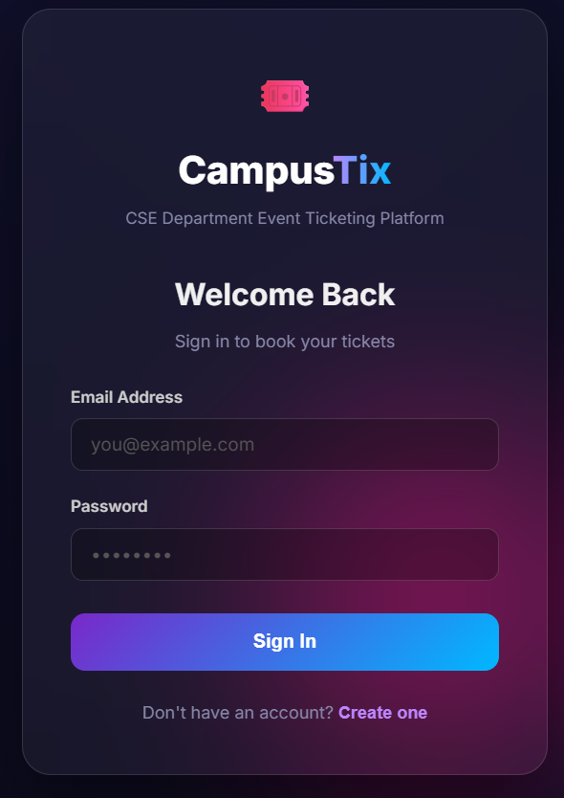
IMPLEMENTATION SCREENSHOTS
1
2
3
4
5
6
7
8c
9
This shows The login interface. It allows users to securely access the platform by entering their email and password. It also provides an option for new users to create an account. This ensures only authenticated users can book ticket

Slide 12
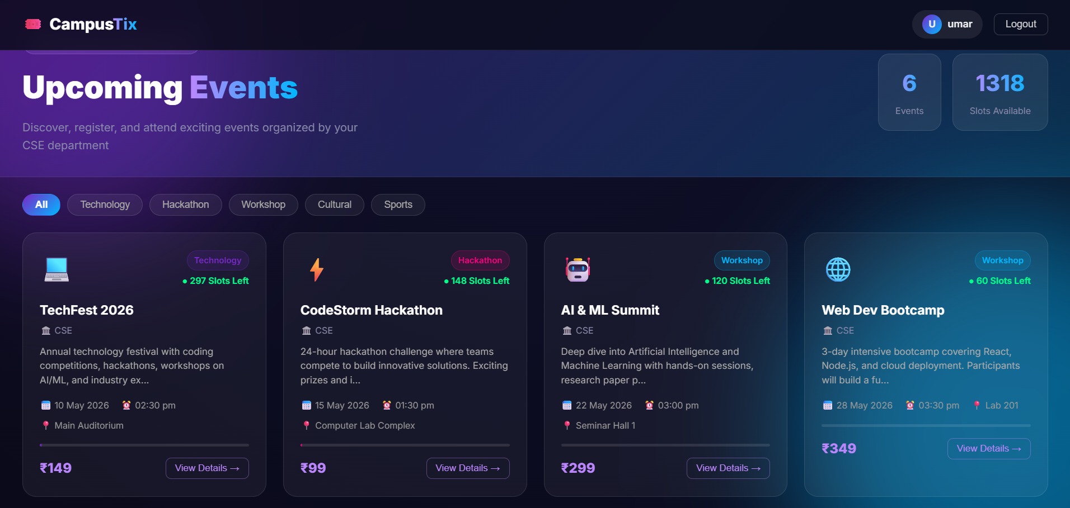
IMPLEMENTATION SCREENSHOTS
1
2
3
4
5
6
7
8d
9
It shows the dashboard that displays all upcoming events with details like date, time, venue, available slots, and price. Users can filter events by category such as technology, hackathon, or workshop. It helps users easily browse and select events..

Slide 13
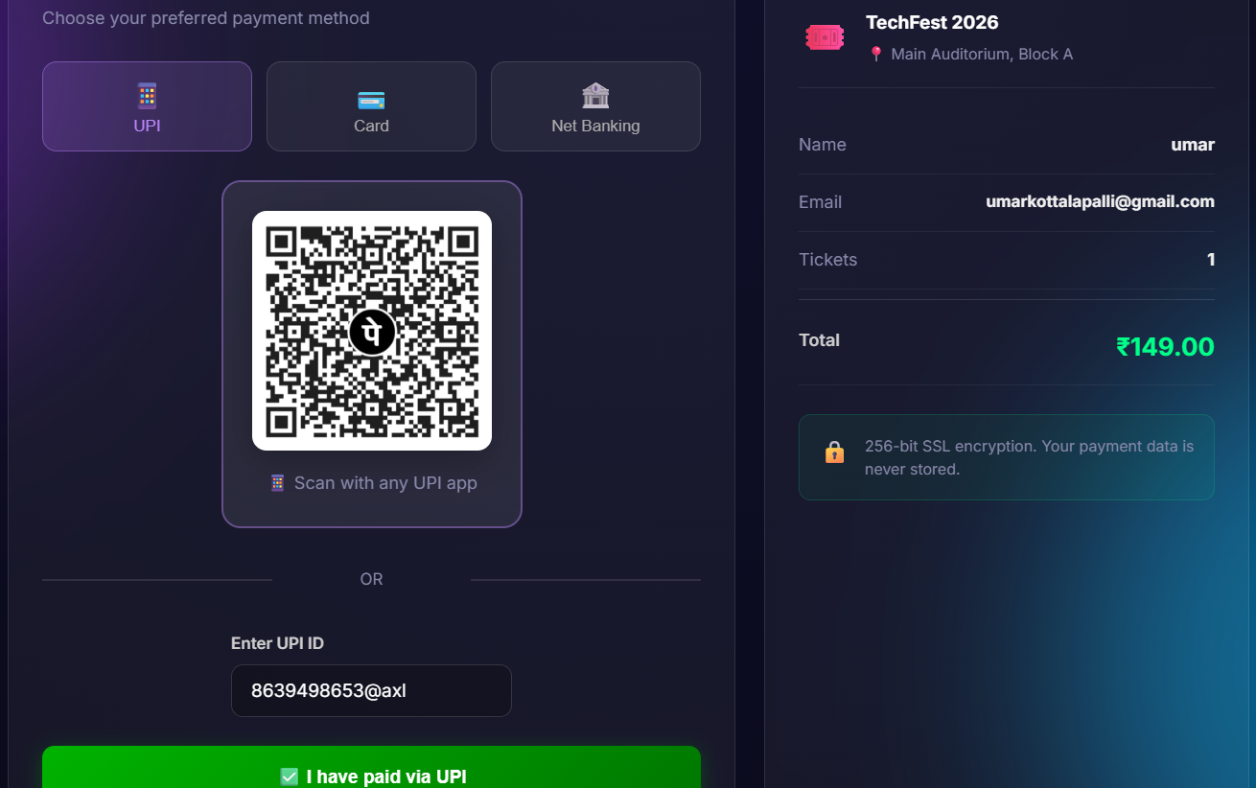
IMPLEMENTATION SCREENSHOTS
1
2
3
4
5
6
7
8e
9
.
It shows the Payment Interface. It enables users to complete ticket booking using methods like UPI, or net banking. It provides a QR code and UPI ID option for payment. This ensures a secure and flexible payment process.

Slide 14
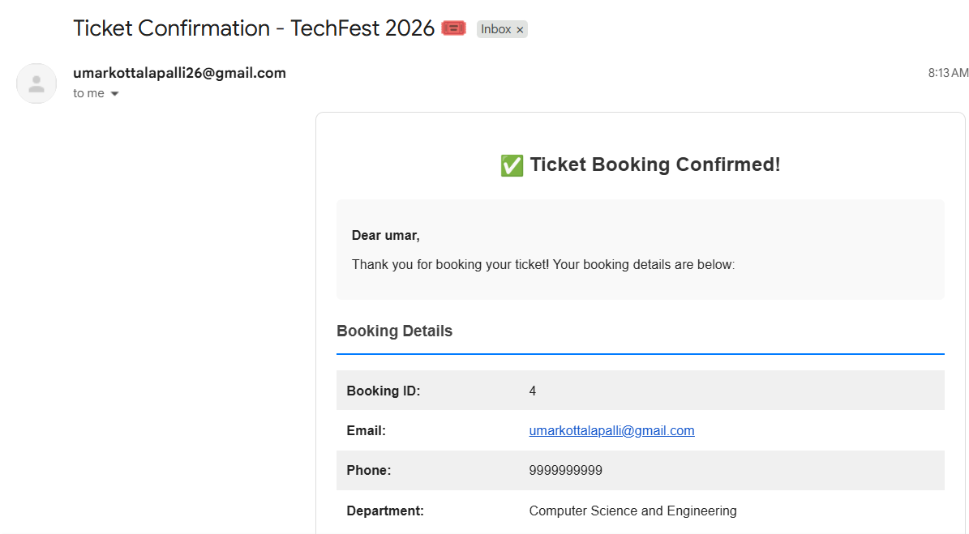
IMPLEMENTATION SCREENSHOTS
1
2
3
4
5
6
7
8f
9
.
This image shows the confirmation email that is sent after successful booking as proof of purchase. It includes booking details like ID, email, and event information.

Slide 15
ADVANTAGES & LIMITATIONS
1
Advantages
2
Real-time ticket availability updates
User-friendly interface (simple and clean UI)
Reduces manual work and errors
Data stored securely in database
3
4
5
6
Limitations
7
Depends on internet connection
The current version is limited to basic ticketing features.
Users must have a computer with at least 4GB of RAM and specific operating systems to run the development environment.
Backend must run continuously (no cloud deployment yet)
8
9

Slide 16
Thank you

